Slide 1

Customer Churn Analysis
Thomas Nguyen

Slide 2
Table of Content
1. Introduction
2. Exploratory Data Analysis
3. Prediction of Customer Churn
4. Conclusion

Slide 3
Introduction

Slide 4
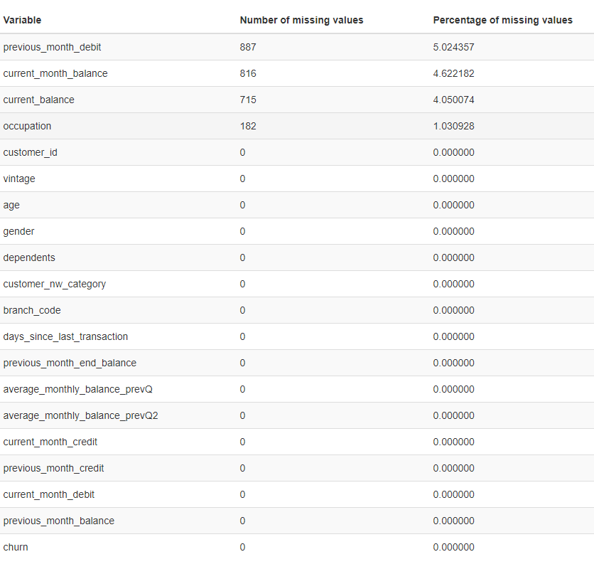
Introduction
Data Wrangling and Cleaning

Slide 5
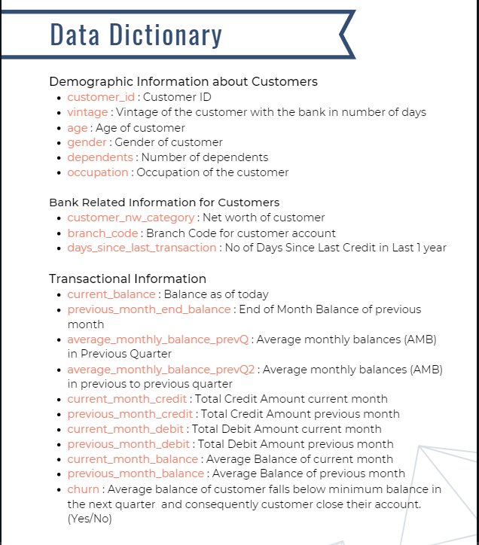
Introduction
Data overview

Slide 6
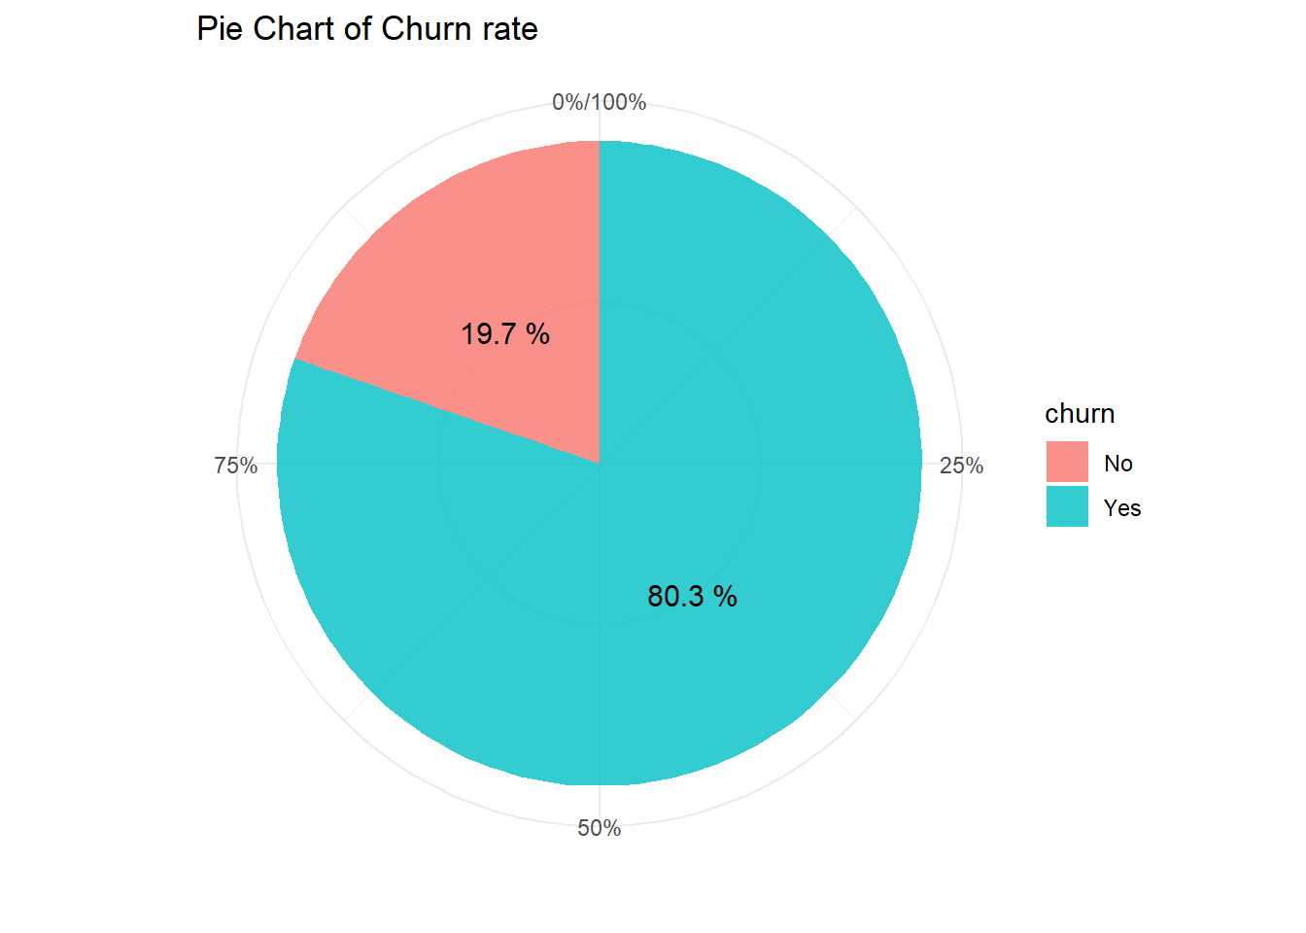
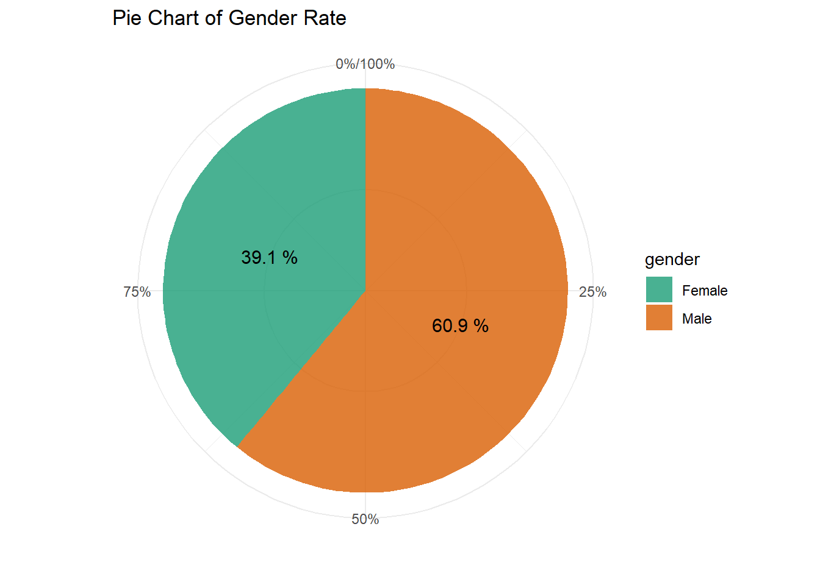
Exploratory Data Analysis Demographic and Churn

Slide 7
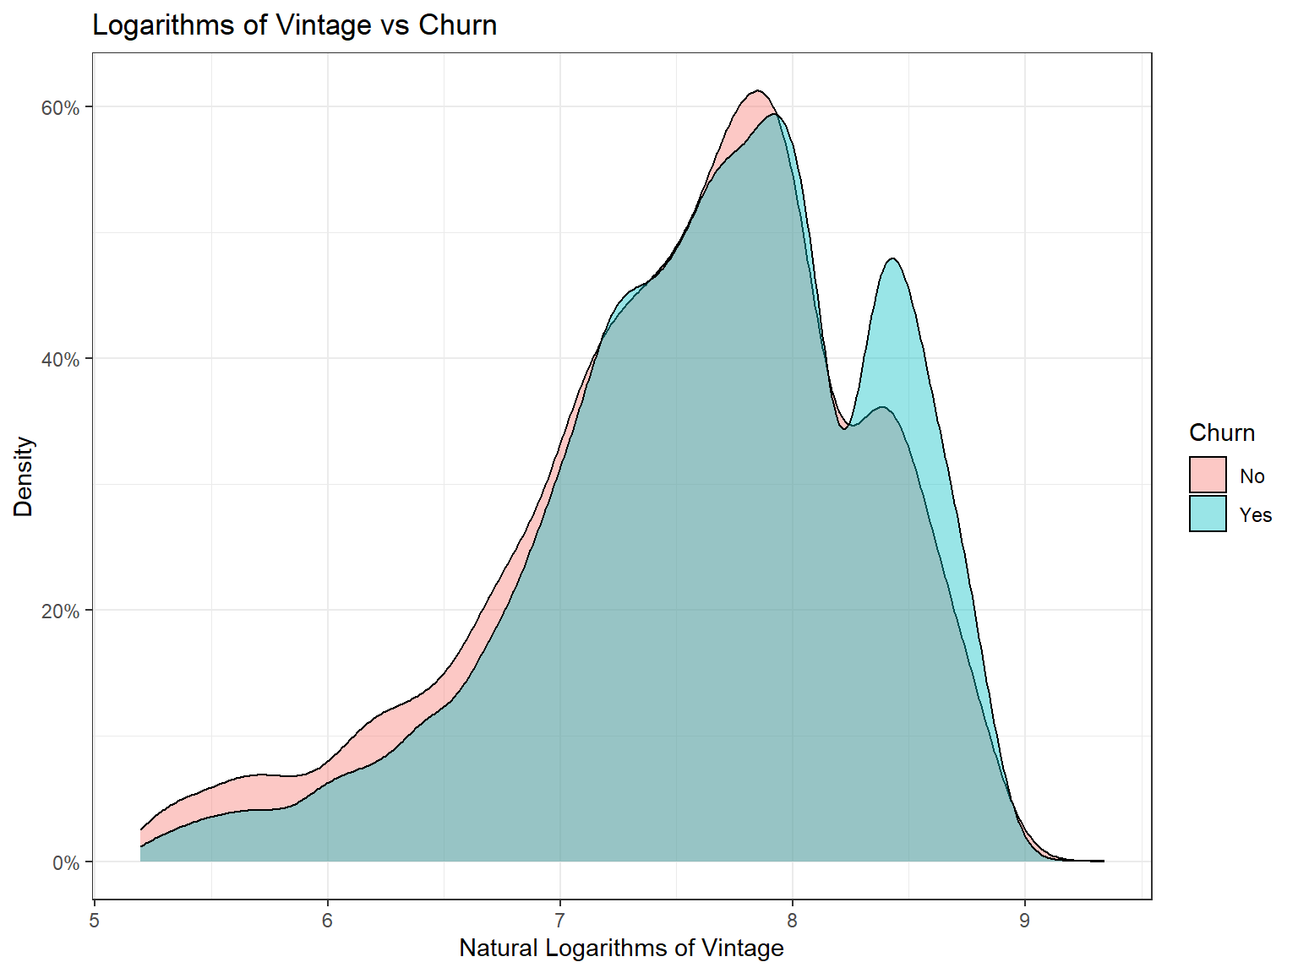
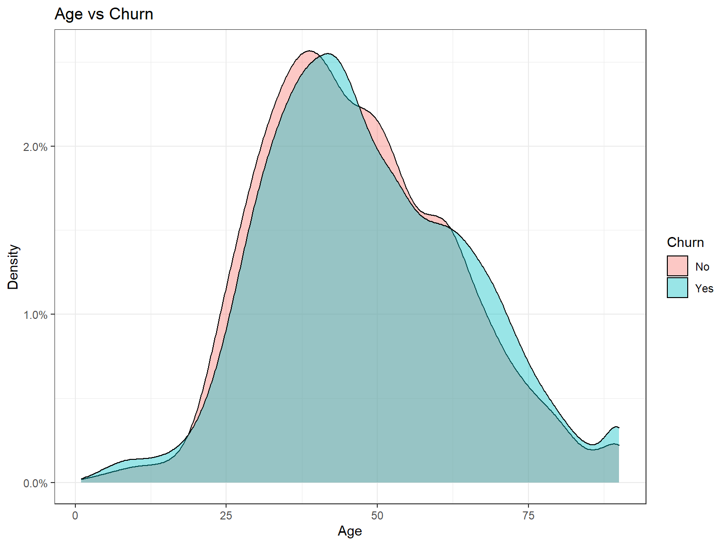
Exploratory Data Analysis Demographic and Churn

Slide 8
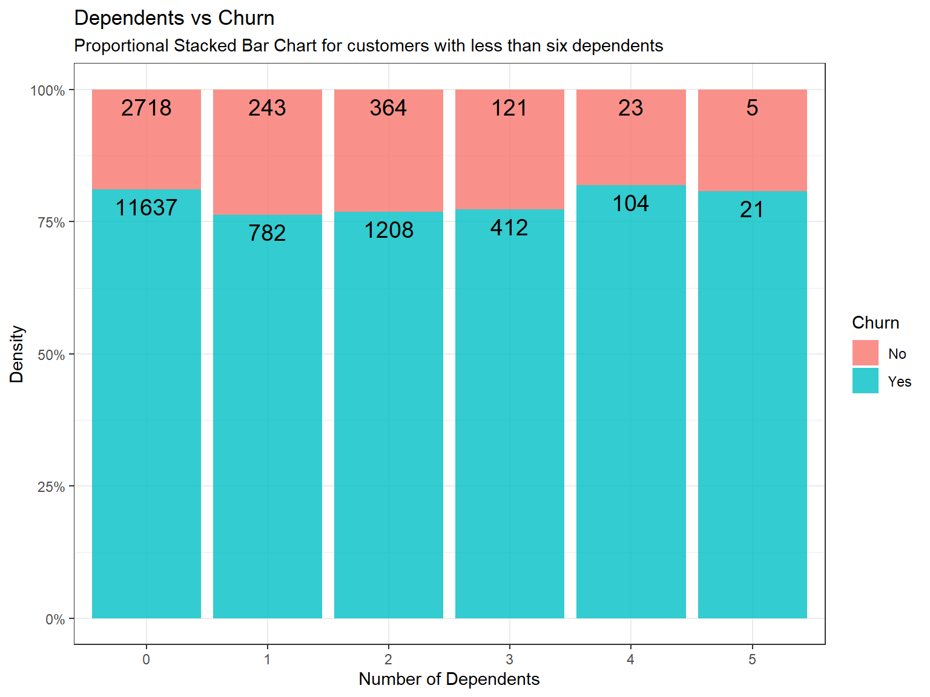
Exploratory Data Analysis Demographic and Churn

Slide 9
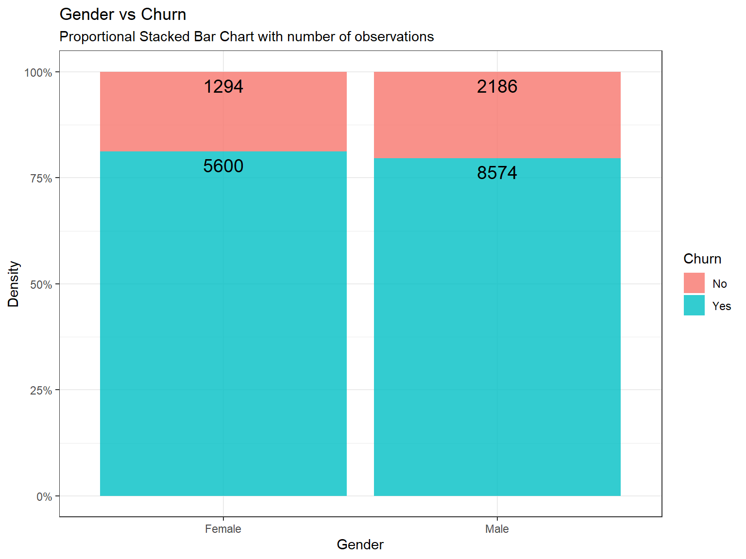
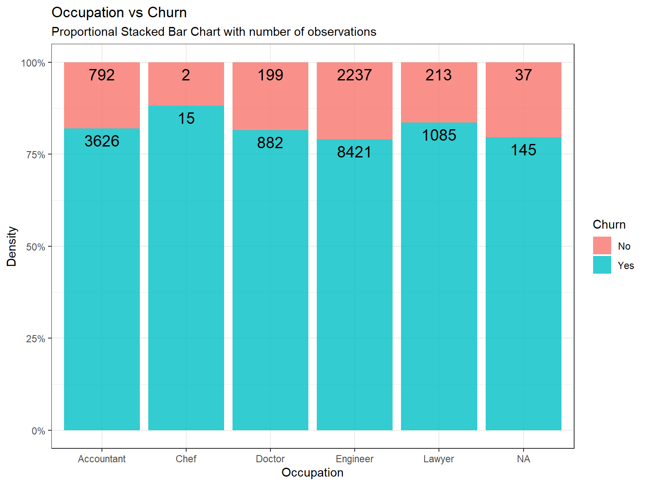
Exploratory Data Analysis Demographic and Churn

Slide 10
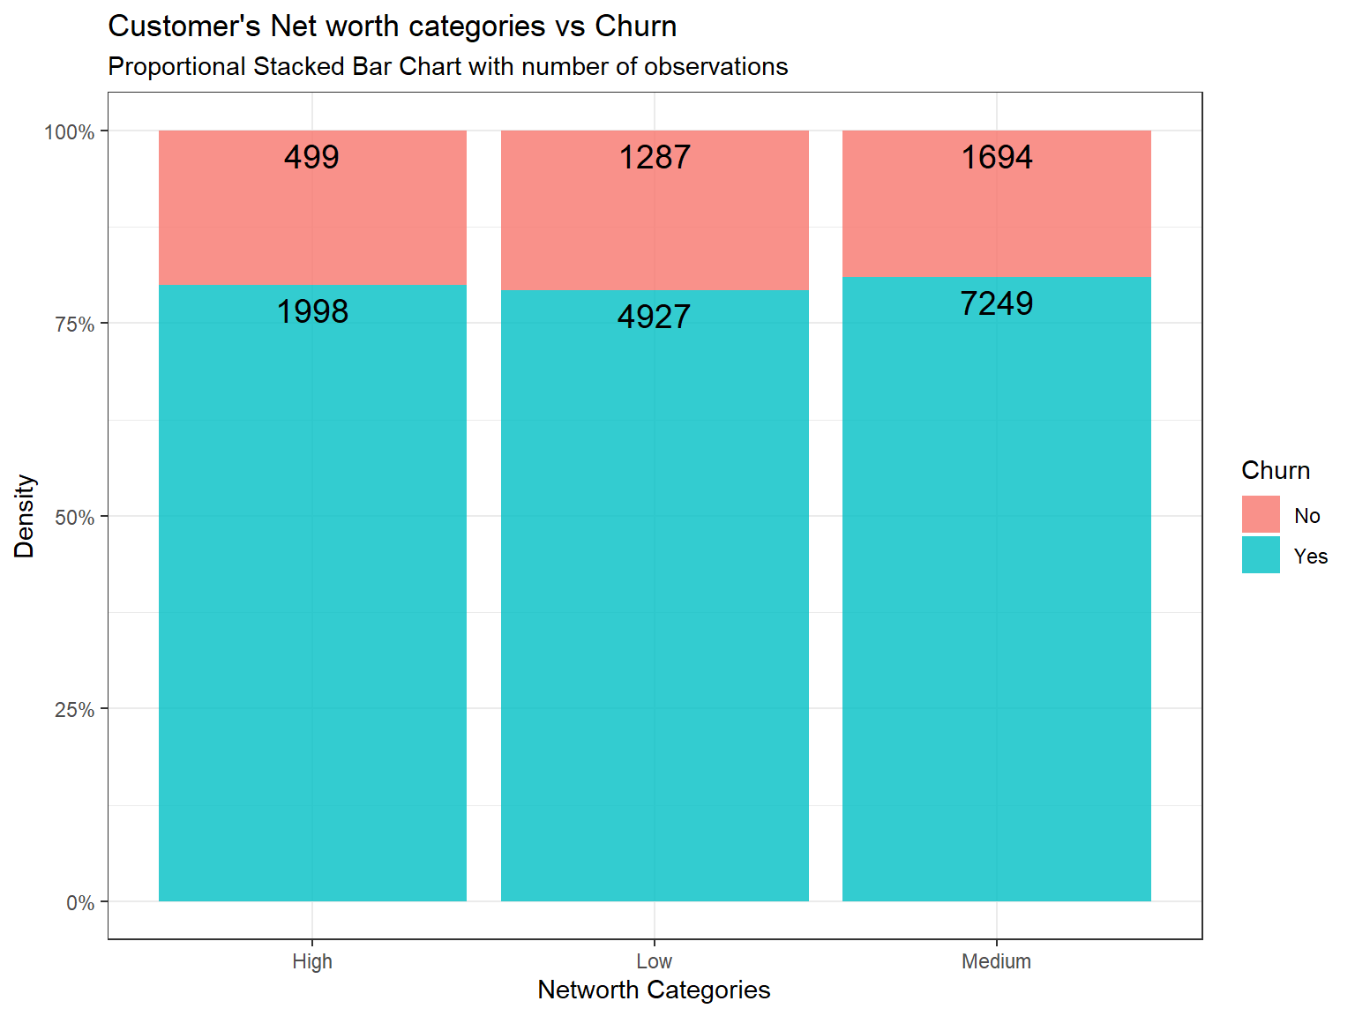
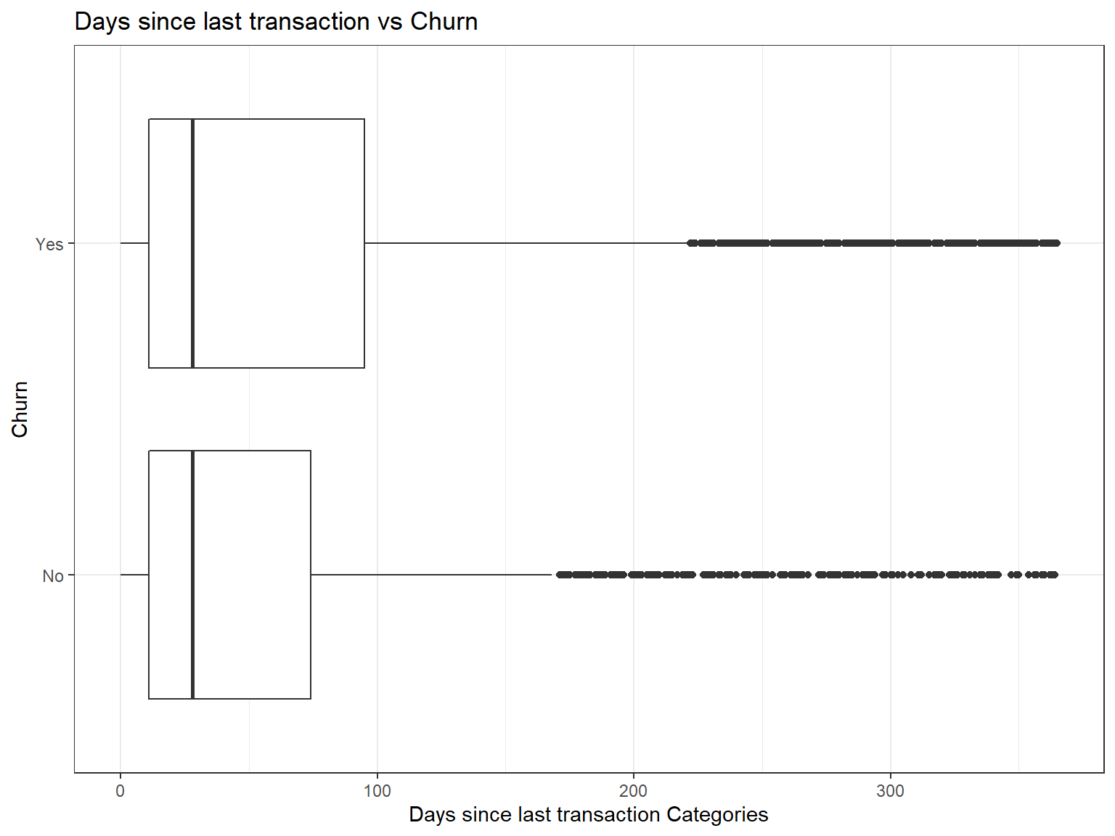
Exploratory Data Analysis Bank related information and Churn

Slide 11
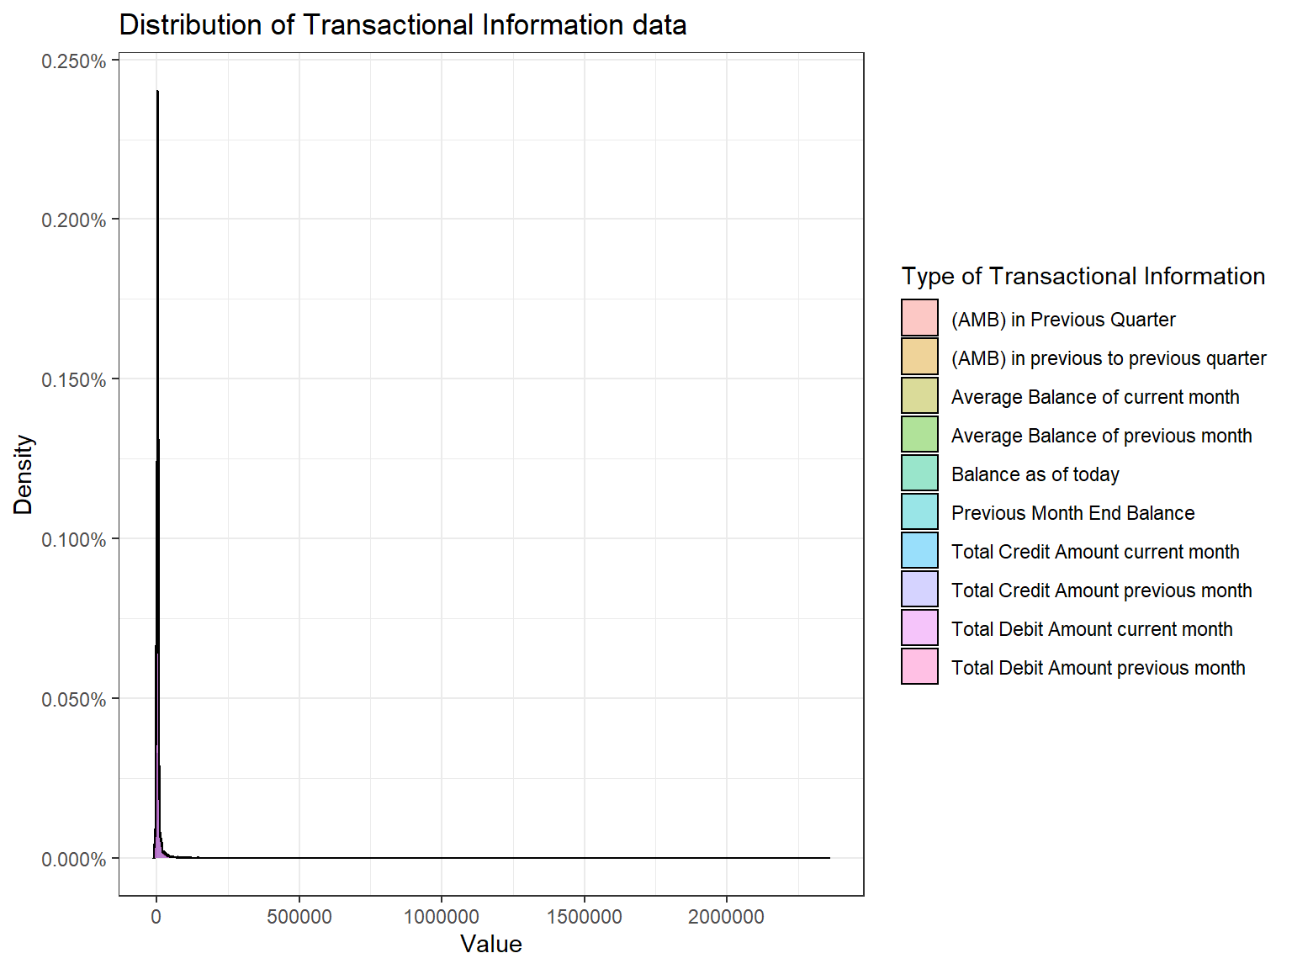
Exploratory Data Analysis
Transactional Information and Churn
Transactional Information data is highly right-skewed.

Slide 12
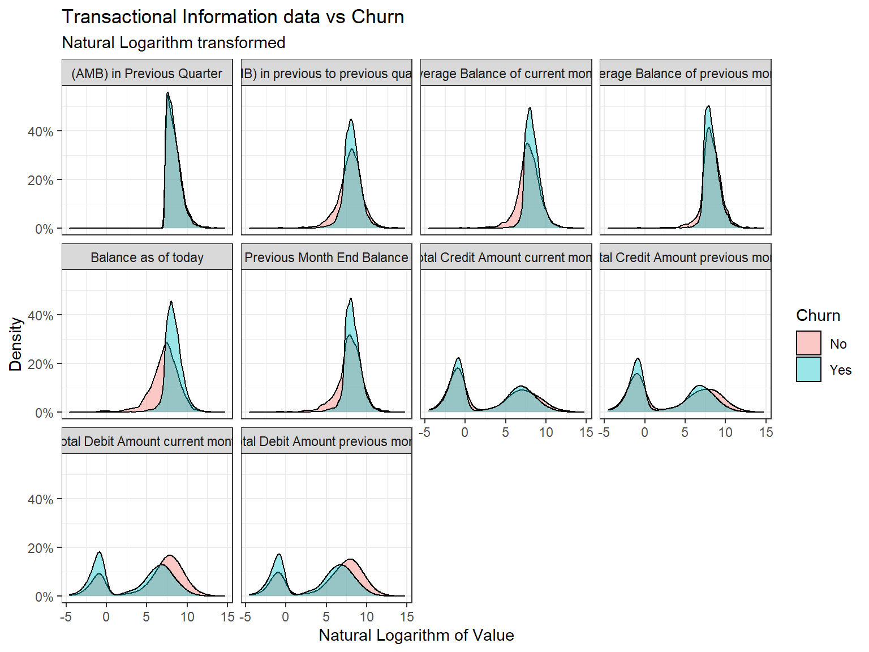
Exploratory Data Analysis
Transactional Information and Churn
Balance as of today, Average Balance of current month. Total Debit Amount in the current month and previous month seems to have some relationship with churn

Slide 13
Exploratory Data Analysis
Conclusion:
The number of observations in each class in Churn is imbalanced.
There is no sign of relationships between demographic variables and Churn.
Distribution of variables is not normal.
Small number of missing values.
Highly skewed data.

Slide 14
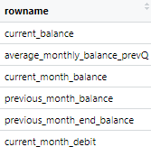
Modelling and Predicting
Modelling:
Random Forest is used.
Data transformation:
The data is upsampled.
Log transformation is done on skewed variables.
Character variables changed to factors.
The choice of variables in the model is done by taking into account the variable importance. Variables are chosen based on MeanDecreaseGini.
Public score: 0.71

Slide 15
Conclusion
Question and Answer

